Slide 1
Design Thinking: Simplified
An online, design thinking handbook for any UX student made by a UX student
Janelle chandass

Slide 2
PROBLEM
People with little or no UX design experience:
Find aspects of the design thinking process ambiguous. There is not always clear understanding of what comes next, which tools or techniques and when
Struggle with the development of some graphics like user flows
Think the process is time consuming, they often need to do a lot of research to find information on best practice or how to create a type of graphic
Have problems coming up with ideas
Other tutorials have large volumes of material, come with considerable time or monetary investment, sign-up

Slide 3
“I feel overwhelmed by the process. I find it tedious and I have trouble generating ideas this way”, Graham, Year 1 Digital Design Student

Slide 4
To help UX designers to work efficiently and create engaging and user-centred digital products.
Vision statement

Slide 5
SOLUTION
Develop an easy-to-use online handbook with the following features
Clear and simple language
Clean and minimalist design since there will be diagrams etc
Responsiveness and accessibility

Slide 6
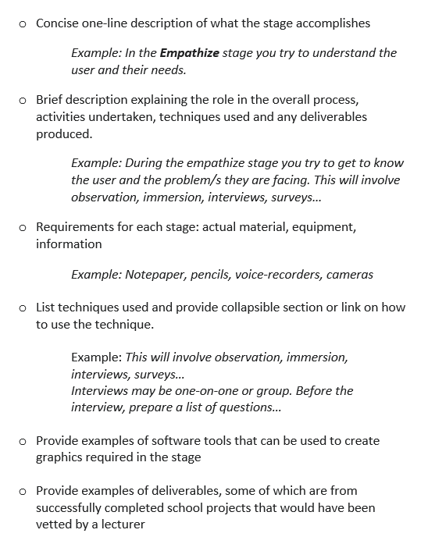
SOLUTION
For each of the five (5) design thinking stages provide

Slide 7
SOLUTION
For each of the five (5) design thinking stages provide

Slide 8
SOLUTION
Explain step-by-step, how graphics and other deliverables of the design thinking process (affinity diagrams, user stories, POV (point of view statement), low-fidelity wireframe, high-fidelity wireframe, test plan and tests) should be developed
Provide simple navigation to the five (5) design thinking stages as well as side panel navigation directly to techniques and tools
Provide a form for users who wish to contribute, request information on a particular topic or provide general feedback

Slide 9
MVP
Responsive and accessible website with simple navigation to all 5 stages
Content for the first stage: Empathize

Slide 10
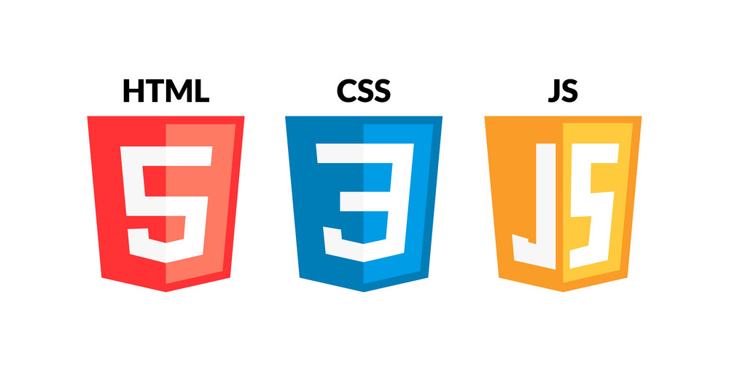
TECH STACK

Slide 11

THE DESIGNER
A recent student of UX design, HTML, CSS and JavaScript herself, Janelle had wanted a one-stop shop for her UX design information and clear guidelines on how to bring it all together. Having navigated several projects and years of teaching experience, she is well equipped to create engaging and useful content.

Slide 12
TARGET MARKET
Anyone interested in learning about UX design or doing UX design for a project, particularly:
UX design students
Developers with little experience in UX design
Novice UX designers
UX designers looking for a different perspective

Slide 13
COMPETITION
Website | Pros | Cons
Design Thinking Blog - IDEO U Articles |  | Contained links to different articles about design, including design thinking, user would need to go through list of articles to determine which were relevant
What is Design Thinking? The Ultimate Beginners Guide (workshopper.com) | Great content, very descriptive | Apart from a few videos, scattered throughout, all text-based without images
The Design Thinking Process: 5 Steps Complete Guide (careerfoundry.com) | Great content, very descriptive | Text-based, no images or examples based on scenarios

Slide 14
COMPETITION
Competitor Websites | Pros | Cons
HECMontrealX: UX Design | edX | Self-paced Well established program by recognised institute Accredited program option | Long duration Large volume of material some of which may be inapplicable to user Considerable time investment
Digital Skills: User Experience - Online Course - FutureLearn | Low time investment Free | Less material Lots of videos, which may not work for all learners
UX Tutorial 1: What Exactly Is UX Design? (Free Course) (careerfoundry.com) | Well established program by recognised institute Good content, has career suggestions, as well as detailed explanations linked to main page Construction of some UX diagrams are described in detail | To learn more, user has to go to separate page In some instances, there is a lot of text where a diagram or example would be more helpful, too much detail for user to sort through

Slide 15
WHAT MAKES THIS WEB-TUTORIAL DIFFERENT?
Driven by data from UX design students and novice designers and tested by them
Content created by an educator with years of experience in lesson planning, creation and delivery
Clean, simple design

Slide 16
THANK YOU
Janelle Chandass
jchandass@northislandcollege.ca

